Slide 1
WOMEN EDUCATION : AN INTRODUCTION 3RD SEMESTER/PAPER-303
BY:-MRS.RINKI KUMARI
DEPTT.OF EDUCATION
MMHA&PU,PATNA
DATE:-12TH AUGUST,2020

Slide 2
INTRODUCTION
The provision of all facilities and opportunities to women for education is called women education.

Slide 4
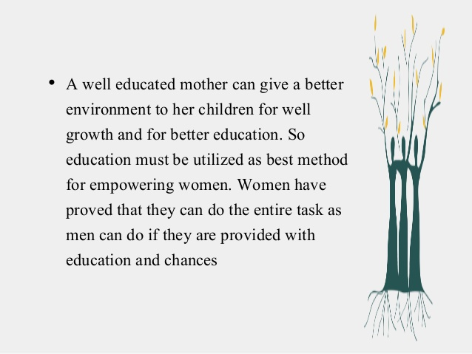

Slide 5
Jawaharlal Nehru had once said:- “Educate a man and you educate one person. educate a women and you educate the whole family”. Gandhiji:- “women should receive education on par with men, if necessary provide them specialized education”.

Slide 6
Swami Vivekananda:- “ There is no chance for the welfare of the world unless the condition of women is improved. it is not possible for a bird to fly on only one wing. there is no hope for that family or country where there is no estimation of women, where they live in sadness. for this region, they have to be raised first.”

Slide 7
Kothari commission-
For full development of our human resources, the improvement of homes and for moulding the character of children during the most impressionable years of infancy, the educate of women is of even greater importance than that of men”.

